Slide 1

Automata Theory Lecture: 8 GTG & NFA
Farhad Muhammad Riaz

Slide 2
Generalized Transition Graphs (GTG)

Slide 3
Definition
A generalized transition graph (GTG) is a collection of three things:
A finite set of states, of which at least one is a start state and some (maybe none) are final states.
An alphabet ∑ of input letters.
Directed edges connecting some pairs of states, each labeled with a regular expression.

Slide 4
Example
Consider this GTG:
This GTG accepts all strings without a double b.
Note that the word containing the single letter b can take the free ride along the Λ-edge from start to middle, and then have letter b read to go to the final state.
Typo in textbook: The first edge should be labeled (ba + a)* as in the figure above, not (ab + a)*.

Slide 5
Note that there is no difference between the Kleene star closure for regular expressions and a loop in transition graphs, as illustrated in the following figure:
In the first picture we may loop in the middle state or go to the third state. To not loop corresponds to taking the Λ choice from the b*-edge in the second picture.

Slide 6
NonDeterminism

Slide 7
NonDeterminisim
We have already seen that in a TG, a particular string of input letters may trace through the machine on different paths, depending on our choice of grouping.
This figure shows part of some TG.
The input string abb can go from state 3 to state 4, or to state 5, depending on whether we read the letters two and one, or all three at once.

Slide 8
NonDeterminisim
The ultimate path through the machine is NOT determined by the input alone. Human choice becomes a factor in selecting the path. The machine does not make all its own determination.
Therefore, we say that TGs are nondeterministic.

Slide 9
NFA to DFA
NFA to FA
Two methods are discussed in this regard.

Slide 10
Method 1:
Since an NFA can be considered to be a TG as well, so a RE corresponding to the given NFA can be determined (using Kleene’s theorem). Again using the methods discussed in the proof of Kleene’s theorem, an FA can be built corresponding to that RE. Hence for a given NFA, an FA can be built equivalent to the NFA. Examples have, indirectly, been discussed earlier.

Slide 11
Method 2:
Since in an NFA, there may be more than one transition for a certain letter and there may not be any transition for certain letter, so starting from the initial state corresponding to the initial state of given NFA, the transition diagram of the corresponding FA, can be built introducing an empty state for a letter having no transition at certain state and a state corresponding to the combination of states, for a letter having more than one transitions. Following are the examples

Slide 12
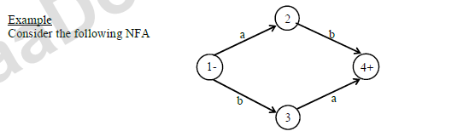
NFA to DFA

Slide 13
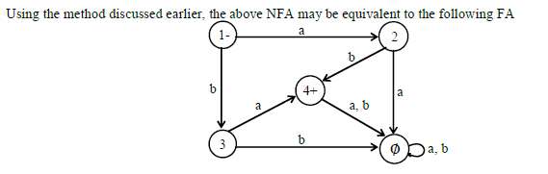
NFA to DFA

Slide 14
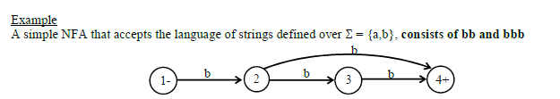
NFA to DFA

Slide 15
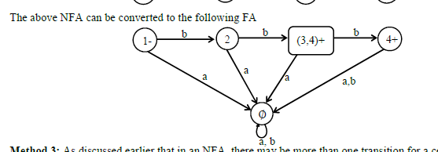
NFA to DFA

